Slide 1
Product Research
sdmay25-29

Slide 2
Project Overview
Implement the Atanasoff-Berry Computer using modern components
The Atanasoff-Berry Computer (ABC) was the first electronic digital computer.
The purpose of the ABC computer was to solve systems of linear equations.
The ABC computer was constructed here at Iowa State.
The original ABC was destroyed in 1948.
We are recreating it as an educational demonstration of how it functioned.
The device that we make will be used as a learning aid to help teach students how computers function.

Slide 3
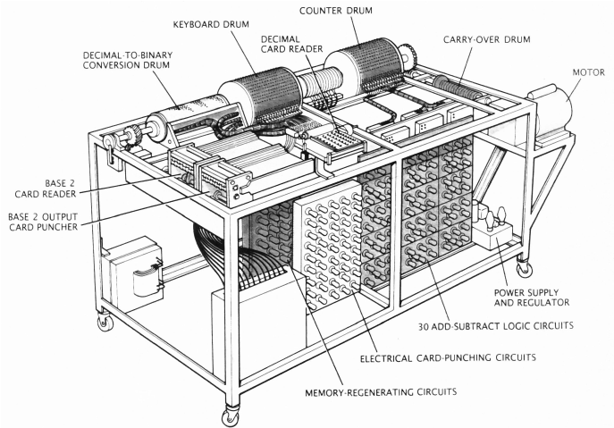
Problem Statement
Perform research to understand how the ABC computer operates. Research the individual components and come up with ideas on how we can implement the separate modules. Prototype the design using breadboards and come up with a final design. Finally, implement the final design as one machine.

Slide 4
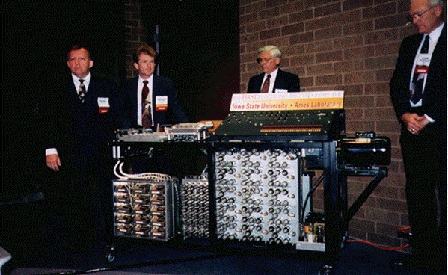
Related Projects
Atanasoff-Berry Computer Replica
Completed in 1997 by a team of 35 people led by John Gustafson and Del Bluhm
Goal was to recreate the ABC using the same technology Atanasoff and Berry used
This project has much more documentation then the original ABC computer.
This project will help us by describing the individual components in enough detail that we should be able to figure out the rest.

Slide 5
Ideas
I/O
Use a printer and scanner to replicate the base-2 puncher and reader (this component is used after converting from base-10 to base-2).
Use number buttons on the machine to input the base-10 equations.
Use a QR code or barcode generator and scanner to input equations.
Adder-Subtractor
Use the same logic as Atanasoff’s vacuum tubes but with modern logic gates.
Prototype the adder-subtractors first by making 4-bit adders.

Slide 6
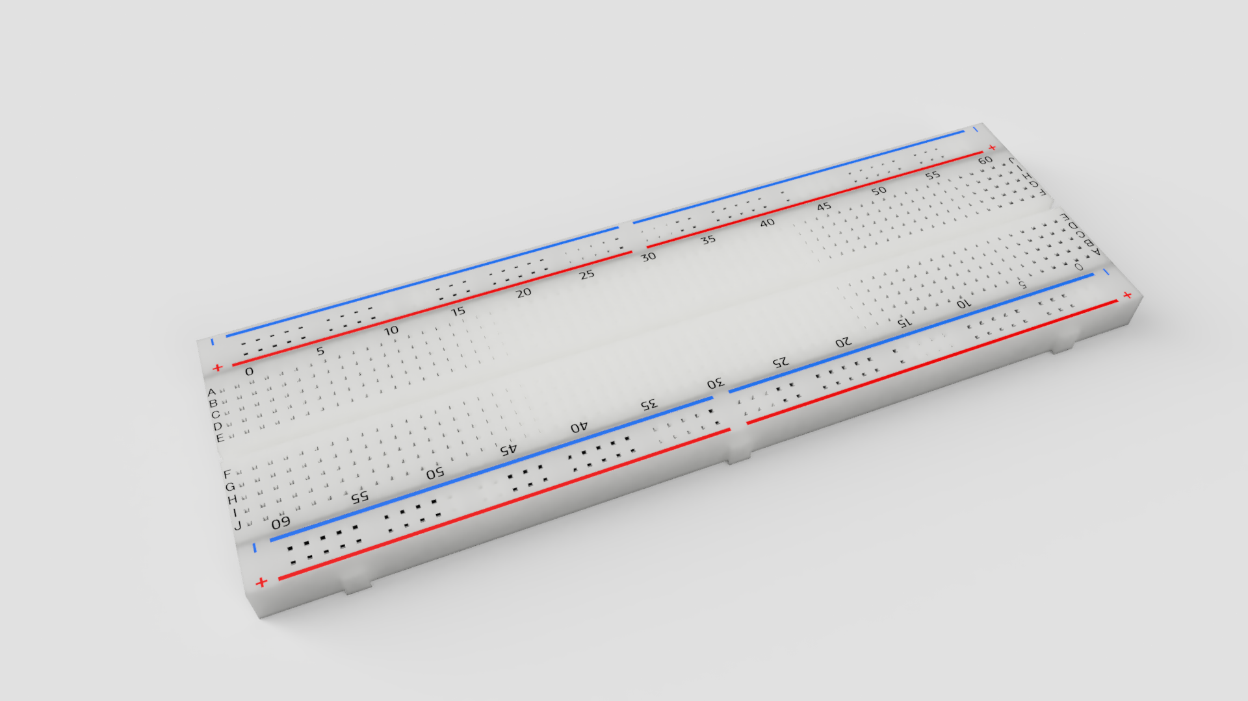
Conclusion
Overall, we all find this project to very interesting and we look forward continuing our research on the original ABC computer. There are still a lot of unknowns around this project as in-depth information is sparse. We will continue researching and filling in our knowledge gaps as we build a prototype.

